Slide 1



CYBERCRIME INCIDENTS ANALYSIS
Good Governance
in Canada (2015-2024)
Kushal Pathapati
December 12, 2025

Slide 2











Project Overview and Objectives
Key Objectives
Analysis Scope
This project analyzes Canadian cybercrime trends from 2015-2024, identifying growth patterns, crime types, and provincial distribution using data analytics.
Identify National Growth Patterns
Analyze year-over-year trends and growth rates across Canada from 2015-2024
Data Cleaning & Transformation
Understand Major Crime Types
R Programming & Power BI
Examine trends in fraud, extortion, identity fraud, and other major cybercrime categories
Compare Provincial Distribution
Analyze geographical concentration of cybercrime incidents across Canadian provinces
| Page 2 of 9

Slide 3














Data Preparation and Methodology
Data Cleaning Process
Data Transformation Process
Remove Commas & Convert to Integers
Wide to Tidy Format
Clean numeric columns by removing commas and converting to integer data type
Convert dataset using pivot_longer() for analysis
Calculate Year-over-Year Change
Standardize Column Names
Compute percentage change in incident counts using lag()
Ensure consistent naming conventions for reliable data access
Aggregate Provincial Data
Remove Non-Province Fields
Sum incidents at provincial level for geographical analysis
Filter out aggregate categories like "Total police-reported cybercrime"
Raw Data
Cleaning
Transformation
Analysis Ready
| Page 3 of 9

Slide 4
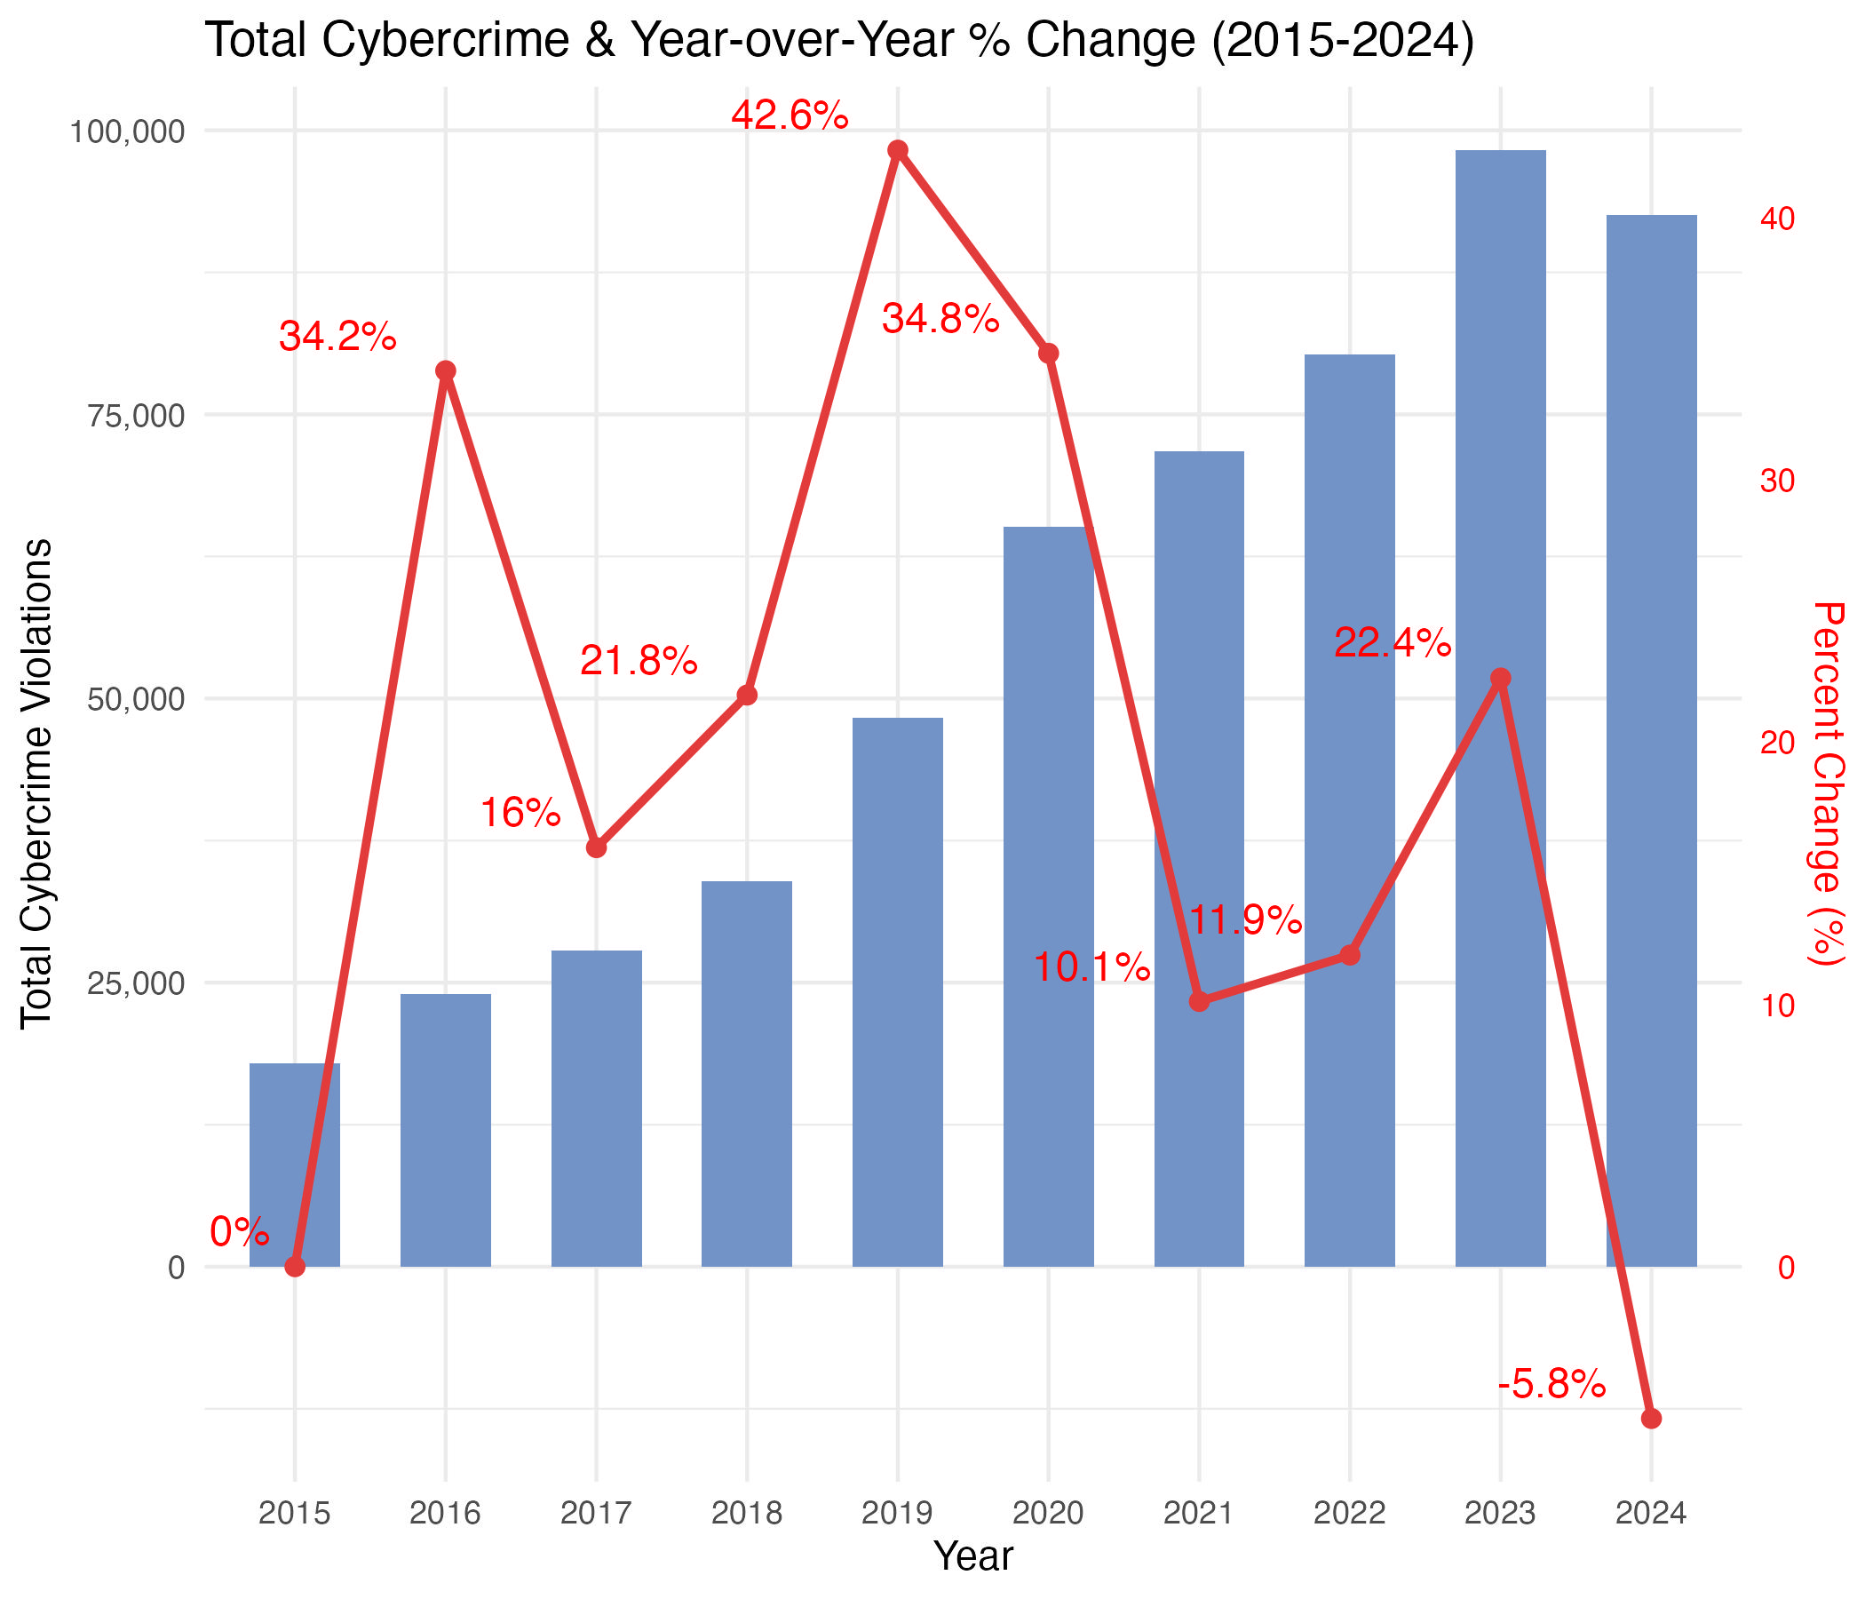






National Cybercrime Trends (2015-2024)
Trend Analysis
Sustained Growth
Significant upward trajectory from 2015-2020
Notable Spikes
34% increase in 2016, 42% in 2019, 35% in 2020
Recent Decline
First recorded decrease of 5.8% in 2024
Despite recent decline, decade-long analysis shows consistent increase in cybercrime incidents
| Page 4 of 9

Slide 5


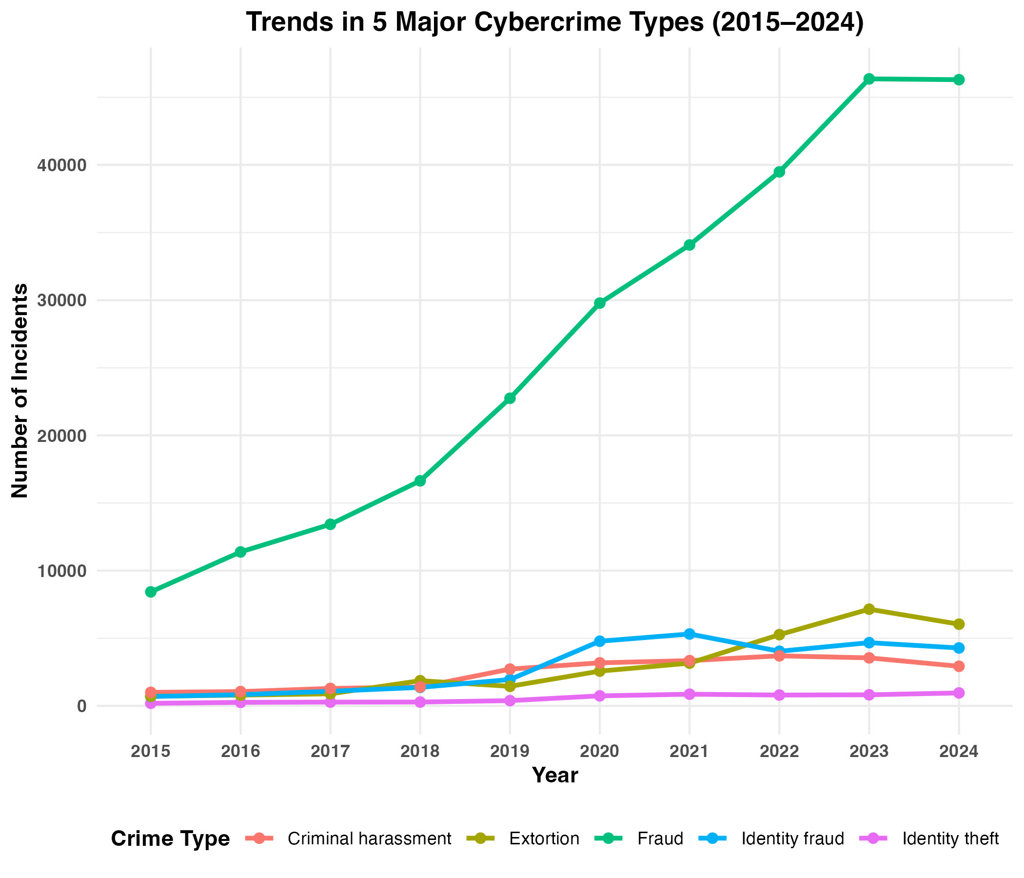






Major Crime Categories Analysis
Analysis of five major cybercrime types reveals distinct growth from 2015 to 2024.
Fraud
Fastest-growing cybercrime, significantly contributing to overall incident totals.
Growth Trends Visualization
Extortion
Notable rise between 2018 and 2023, indicating increasing threat.
Identity Fraud & Theft
Peak in 2020, numbers stabilized, suggesting potential plateau.
Criminal Harassment
Slower growth rate compared to others, yet remains a persistent concern.
| Page 5 of 9

Slide 6
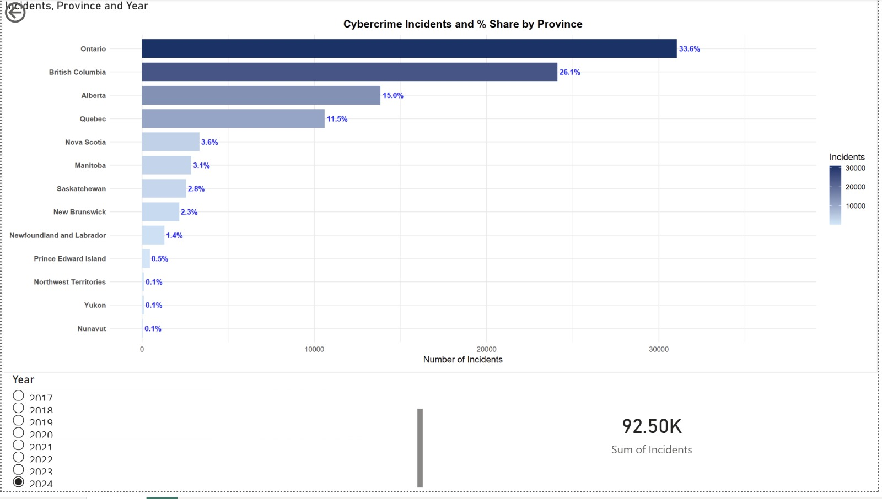






Provincial Distribution in 2024
Key Insights
Incident Concentration
Ontario leads with 34% of incidents, followed by British Columbia (26%) and Alberta (15%), with Atlantic Provinces + Territories accounting for less than 10%.
Population Density Correlation
Incident distribution largely reflects population density patterns, with major urban centers showing higher concentrations of cybercrime.
Regional Trends
Western provinces show a growing share of cybercrime incidents, while territories consistently show the lowest incident counts due to smaller populations.
Page 6 of 9

Slide 7

















Key Findings and Insights
National Trend Insights
Geographical Distribution
Significant and sustained increase between 2015-2020, establishing cybercrime as a growing national concern
Clear concentration in major population centers across Canada
Notable growth spikes in 2016 (34%), 2019 (42%), and 2020 (35%)
Ontario (34%), British Columbia (26%), and Alberta (15%) account for majority of incidents
2024 marked the first recorded decline (-5.8%) after a decade of growth
Growing share of incidents in western provinces
Territories consistently show the lowest incident counts
Crime Type Patterns
Fraud consistently stands out as the fastest-growing and highest-volume cybercrime
Notable rise in extortion incidents between 2018-2023
Identity fraud reached peak in 2020, then stabilized
| Page 7 of 9

Slide 8
install.packages("tidyverse")
library(tidyverse)
# Read Data
cybercrime_data <- read_csv("Cybercrime.csv")
cybercrime_data
# Calculating percent change over years
cyber_crime <- mutate(cybercrime_data,percent_change = (Total_violations –
lag(Total_violations))/lag(Total_violations)*100,percent_change = replace_na(percent_change, 0))
cyber_crime$percent_change
# Scaling the values of % change to fit in graph with total_violations
scale_factor <- max(cyber_crime$Total_violations) /
max(abs(cyber_crime$percent_change))
scale_factor
library(ggplot2)
ggplot(cyber_crime, aes(x=factor(Year))) +
geom_col(aes(y = Total_violations),fill = "#7293C7", width = 0.6) +
geom_line(aes(y = percent_change * scale_factor, group = 1),
color = "#E23B3B", size = 1.1) +
geom_point(aes(y = percent_change * scale_factor),
color = "#E23B3B", size = 2)+
geom_text(aes(y = percent_change * scale_factor,
label = paste0(round(percent_change,1), "%")),
vjust = -.7,hjust=1.4, color = "red", size = 4) +
scale_y_continuous(
name = "Total Cybercrime Violations",
labels = comma,
sec.axis = sec_axis(
trans = ~ . / scale_factor,
name = "Percent Change (%)" )) +
theme_minimal() +
labs(
title = "Total Cybercrime & Year-over-Year % Change (2015-2024)",
x = "Year"
) +
theme(
axis.title.y.right = element_text(color = "red"),
axis.text.y.right = element_text(color = "red")
)
cybercrime_data
crime_vars <- c("Fraud",
"Identity theft",
"Identity fraud",
"Extortion",
"Criminal harassment")
crimes<-cybercrime_data %>%
select(Year, all_of(crime_vars))
crimes
cyber_long <- crimes %>%
pivot_longer(
cols = -Year,
names_to = "Crime_Type",
values_to = "Count"
)
cyber_long
ggplot(cyber_long,
aes(x = factor(Year),
y = Count,
colour = Crime_Type,
group = Crime_Type)) +
geom_line(size = 1.1) +
geom_point(size = 2) +
labs(
title = "Trends in 5 Major Cybercrime Types (2015–2024)",
x = "Year",
y = "Number of Incidents",
colour = "Crime Type"
) +
theme_minimal() +
theme(
plot.title = element_text(hjust = 0.5, face = "bold"),
axis.text = element_text(face = "bold"),
axis.title = element_text(face = "bold"),
legend.title = element_text(face = "bold"),
legend.position = "bottom"
)
| Page 8 of 9

Slide 9
dataset <- read_csv("province_wise.csv")
dataset
transformed <- dataset %>% pivot_longer(cols = -Year, # all columns except Year
names_to = "Province", # new column with province names
values_to = "Incidents")
a<-filter(transformed,Year==2024)
a
library(scales)
ggplot(a, aes(x = Incidents, y = reorder(Province, Incidents), fill = Incidents)) +
geom_col(width = 0.8) +
# Percentage labels
geom_text(aes(label = sprintf("%.1f%%", Incidents / sum(Incidents) * 100)),
hjust = -0.1,
size = 3.8,
color = "blue",
fontface = "bold") +
scale_fill_gradient(low = "#cfe8fb", high = "#08306b") +
labs(
title = "Cybercrime Incidents and % Share by Province",
x = "Number of Incidents",
y = NULL
) +
theme_minimal(base_size = 13) +
theme(
plot.title = element_text(face = "bold", hjust = 0.5),
axis.text.y = element_text(face = "bold")
) +
xlim(0, max(a$Incidents) * 1.20)
| Page 9 of 9

